Slide 1
A tutorial explaining by example Tryton installation & usage for first time administrators & users of the system - Usage : Sale
Tryton By Example
Github - https://github.com/clixwise/tryton-by-example Version of documentation : 01.01 Dated 28-Apr-21 Version of Tryton : 5.8 Verified for execution on : Windows 10 & Powershell 7 Documentation : GNU GPL Author : Marc Rottiers

Slide 2
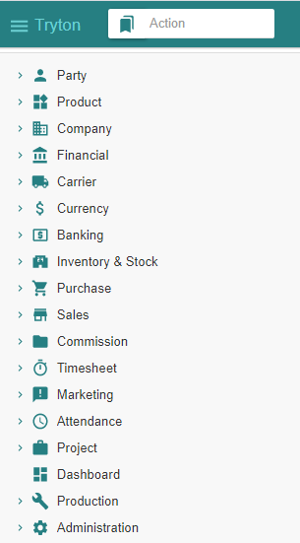
Table of Contents

Slide 3
TOC
Customer
Product
Inventory & Stock
Sale
State Change - Impact Analysis Model
Customer Sale
Customer Shipment
Customer Invoice
Customer Payment
Customer-related modules have been activated
Product-related modules have been activated
Stock-related modules have been activated
Activating Sale-related modules
The entities that record changes when performing “Sale” related operations
Recording a Sale
Recording a Shipment
Emitting an Invoice
Paying an Invoice

Slide 4
Customer

Slide 5
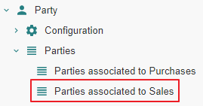
Motivation
Customers are named « Parties associated to Customers ». We name them hereafter « Customer » for commodity.
Customers are in fact party entity roles : any party becomes a customer as soon as one or more sales are linked to it.
Creation : a customer can be initially defined by creating an instance using the Menu Tree Item « Parties » or « Parties associated to Sales ».
Access : as long as no sale is linked to that party, it is not recognized as a customer and will only be accessible using the Menu Tree Item « Parties ».
Note finally that « Party » modules have been activated as explained in the previous document « Basic Functionalities ».

Slide 6
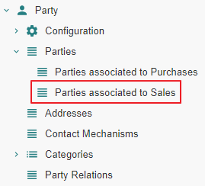
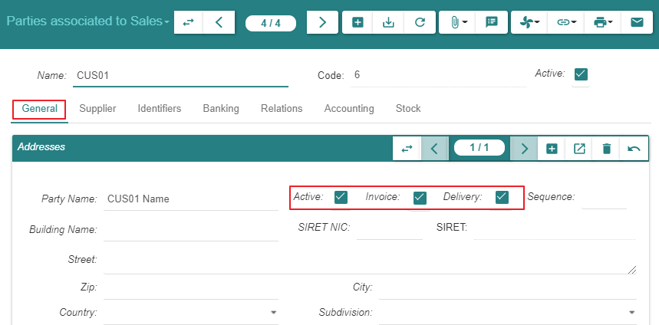
Create

Slide 7
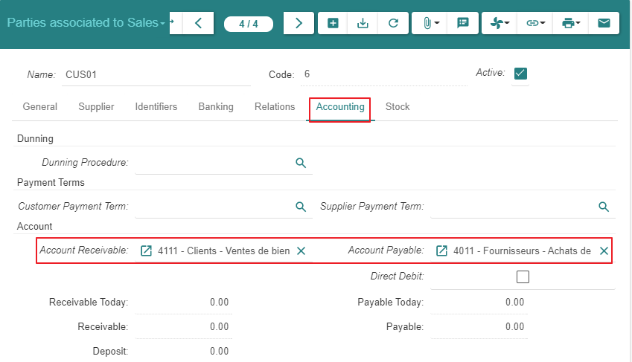
Create

Slide 8
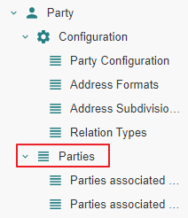
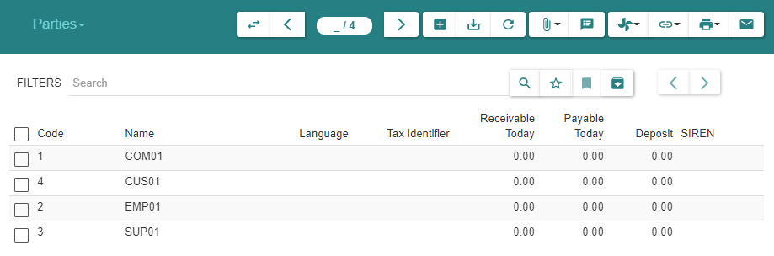
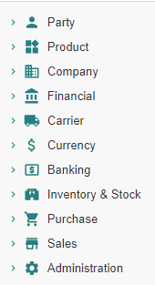
Summary
As explained under « Motivation », the customer always appears in the list « Parties » above
As long as there are no sales linked to the customer, it is absent from « Parties associated to Sales »
When at least one sale exists, the customer will appear in both lists : « Parties » and « Parties associated to Sales »

Slide 9
Product

Slide 10
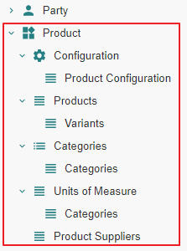
Motivation
Subject Area « Purchase » : « Product » related modules have been activated
Subject Area « Purchase » : a « Product » and its « Variant » have been defined

Slide 11
Inventory & Stock

Slide 12
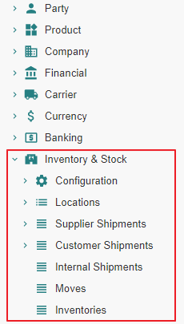
Motivation
Subject Area « Purchase » : « Inventory & Stock » related modules have been activated

Slide 13
Sale

Slide 14
Module Activation

Slide 15
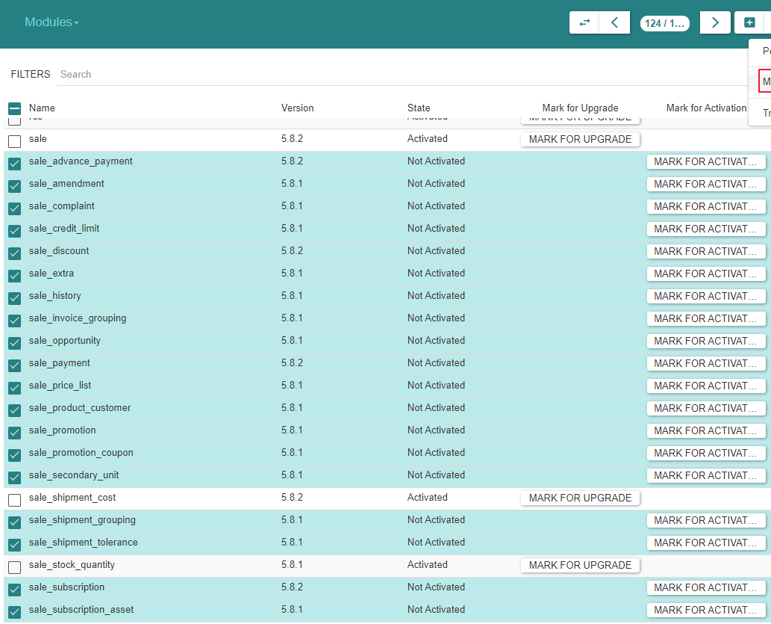
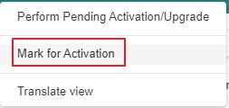
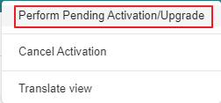
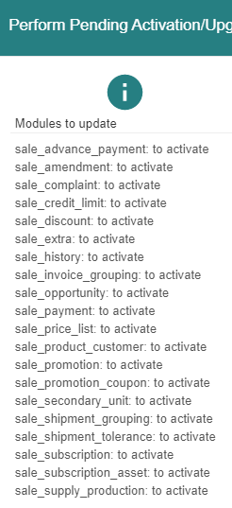
Module Activation

Slide 16
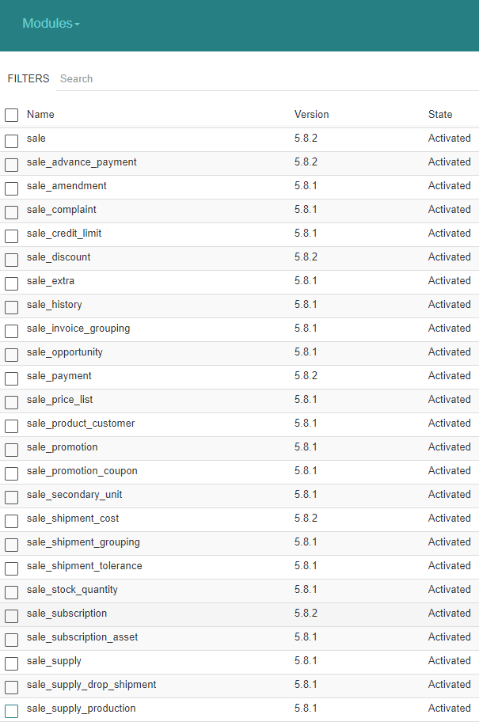
Module Activation

Slide 17
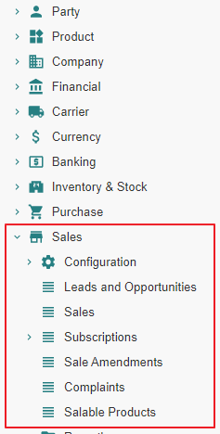
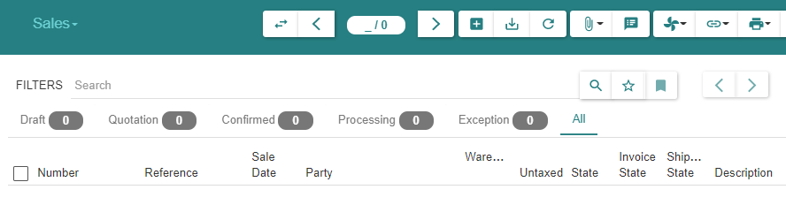
State « Post »

Slide 18
Sale Configuration

Slide 19
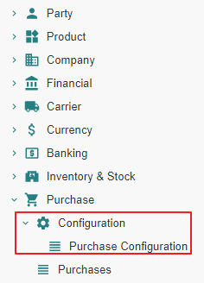
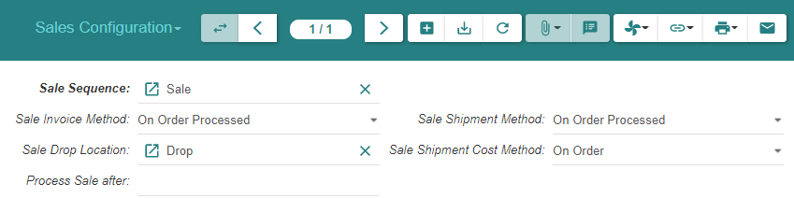
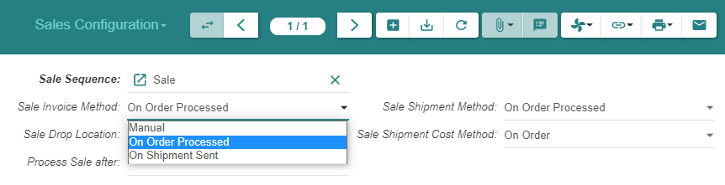
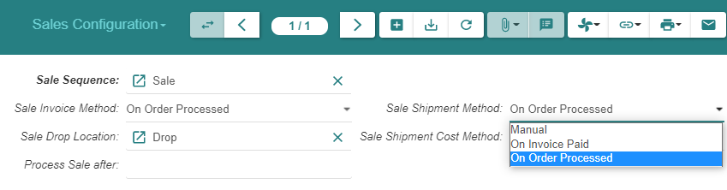
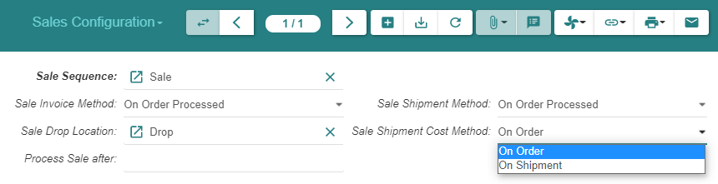
Sale Configuration (1/2)

Slide 20
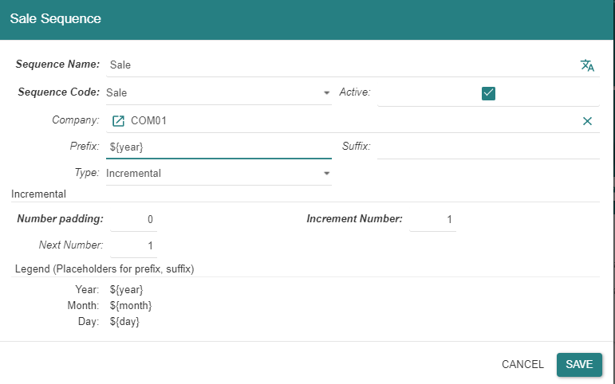
Sale Configuration (2/2)

Slide 21
Sale - State Changes - Impact Analysis Model

Slide 22
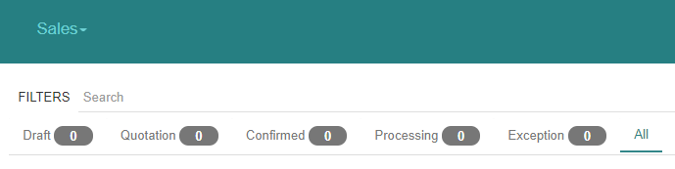
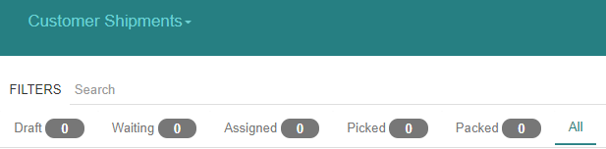
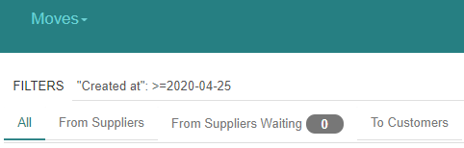
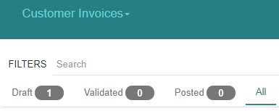
« Sales » related states

Slide 23
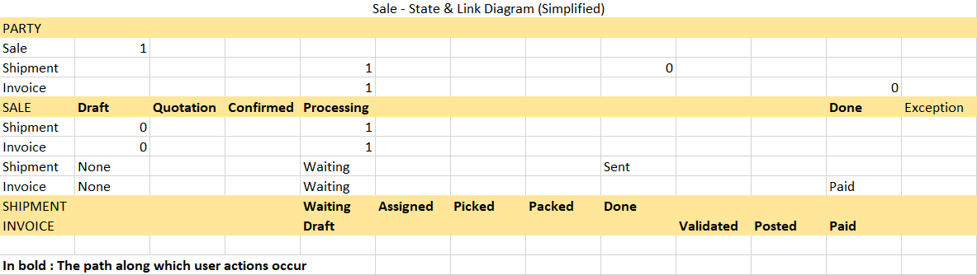
The basic State Diagram for « Sales »
The diagram does not display the action that triggers the state transition

Slide 24
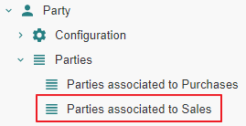
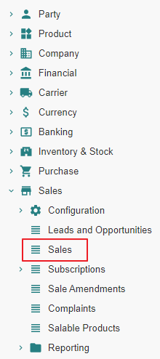
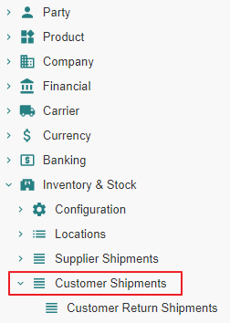
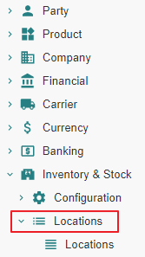
Impact analysis

Slide 25
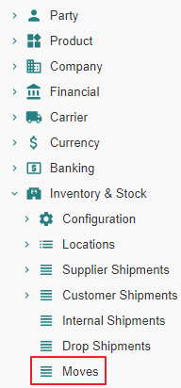
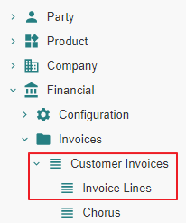
Impact analysis

Slide 26
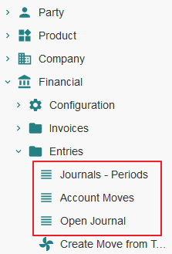
Impact analysis

Slide 27
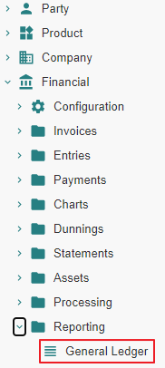
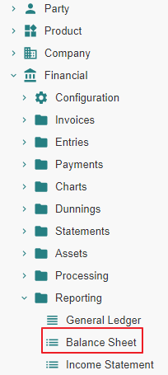
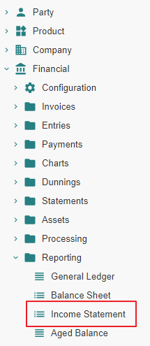
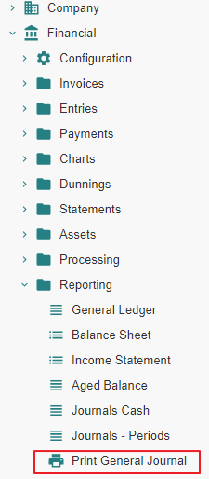
Impact analysis

Slide 28
Customer Sale - State Changes - Impact Analysis

Slide 29
Sale From State « Nill » to State « Draft »

Slide 30
Sale From State « Nill » to State « Draft » Action

Slide 31
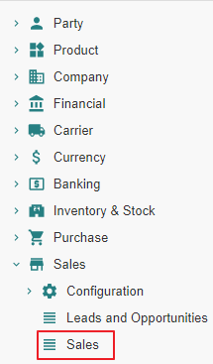
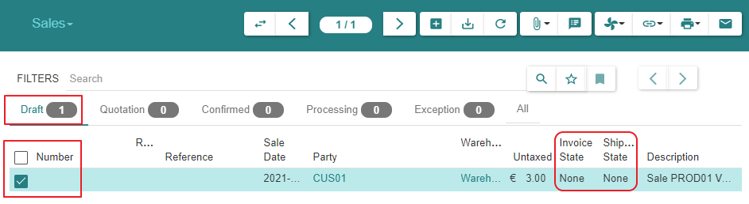
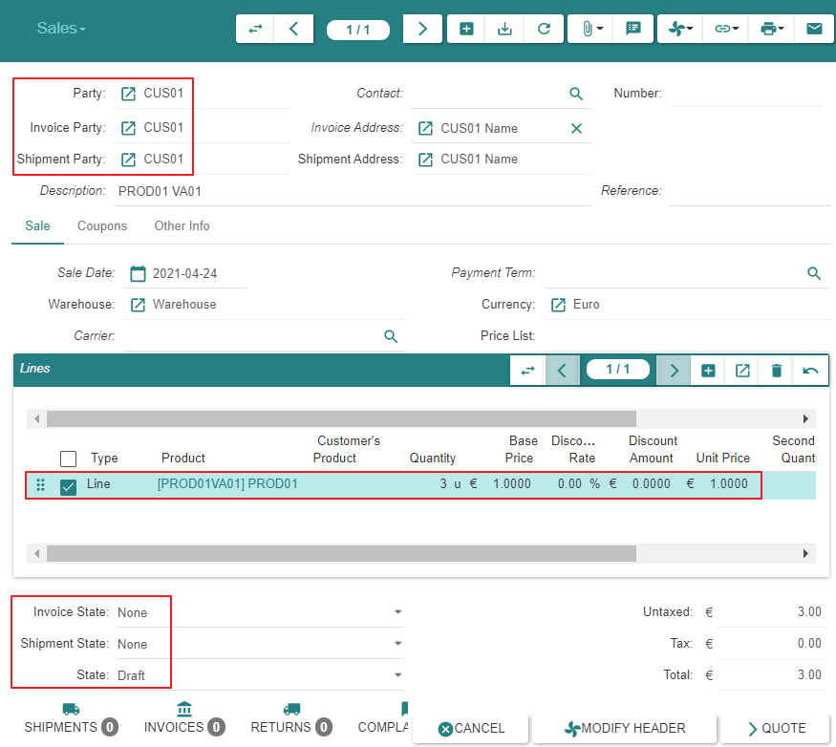
Sale
Sales are not numbered whilst they are in state « Draft »

Slide 32
Sale From State « Nill » to State « Draft » Impact

Slide 33
Sale - From « Nill » To « Draft »
 |  | State | Created - Updated - Deleted -Linked
Customer
Parties associated to Sales | 1 |  | Linked to Sale
Sale
Sales (Customer) | 2 | Draft | Created
Shipment
Customer Shipments (Customer) | 3
Stock
Stock Locations | 4
Stock Moves | 5
Invoice
Invoices (Customer) | 6
Invoice Lines | 7
Payment
Lines to Pay | 8
Payments | 9

Slide 34
Sale - From « Nill » To « Draft »
 |  | State | Created - Updated - Deleted -Linked
Accounting
Journals - Periods | 10
Account Moves | 11
Open Journal | 12
General Ledger | 13
Balance Sheet | 14
Income Statement | 15
General Journal | 16

Slide 36
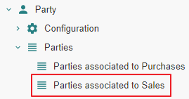
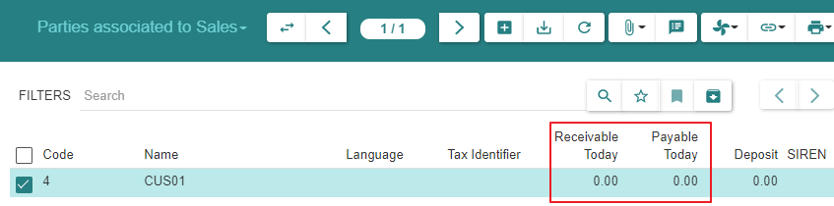
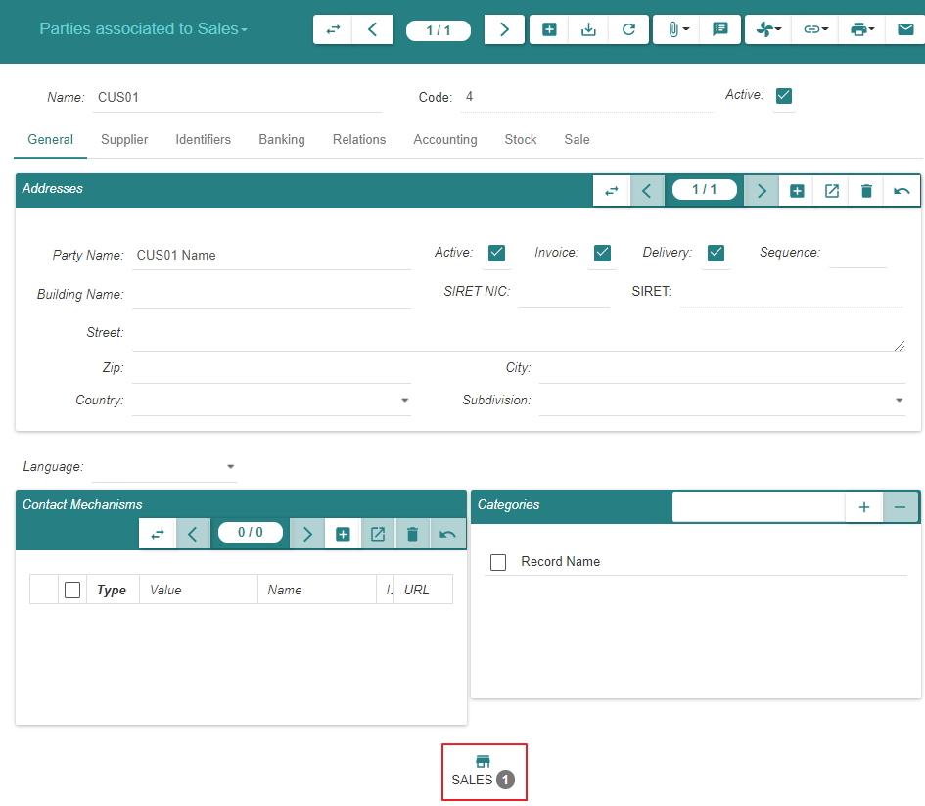
1 - Parties associated to Sales
We can navigate to « Sales », « Shipments » or « Invoices » from here on or from Menu Items

Slide 37
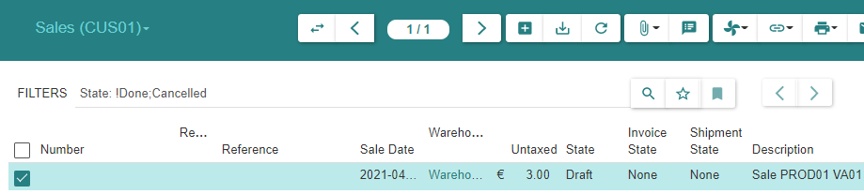
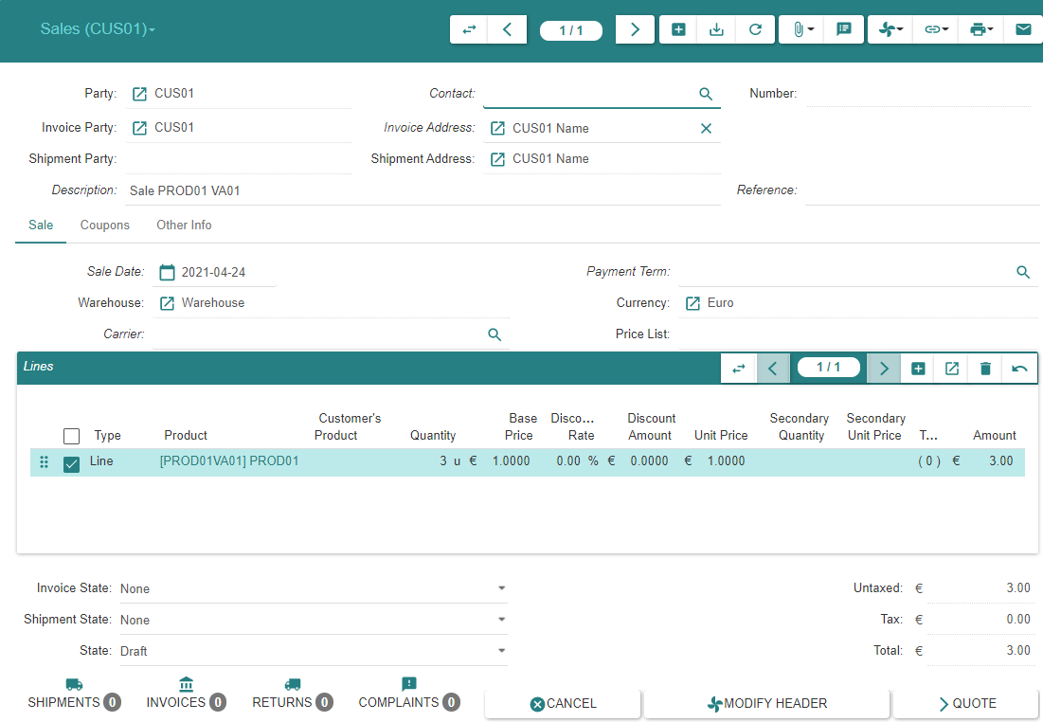
2 - Sales | Sales (SUP01)

Slide 38
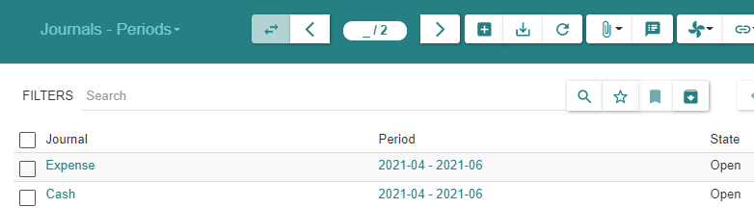
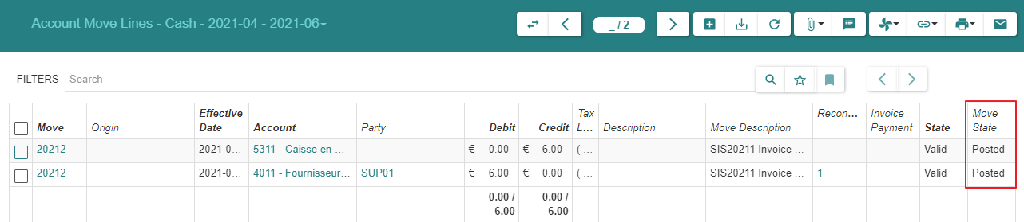
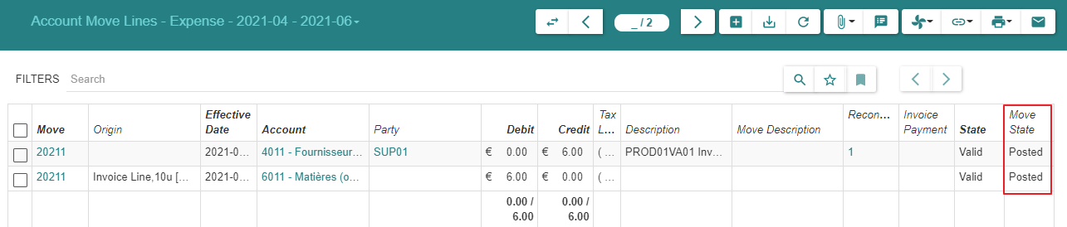
10 - Journals - Periods

Slide 39


11 - Account Moves

Slide 40

11 - Account Moves

Slide 41


12 - Open Journal

Slide 42


12 - Open Journal

Slide 43

13 - General Ledger

Slide 44

14 - Balance Sheet

Slide 45

14 - Balance Sheet

Slide 46


16 - General Journal

Slide 47
Sale From State « Draft » to State « Quotation »

Slide 48
Sale From State « Draft » to State « Quotation » Action

Slide 49


Sale
Sales are numbered when they reach state « Quotation »
Sales can be returned to state « Draft », e.g. when the price has been renegociated with the « Customer »

Slide 50
Sale From State « Draft » to State « Quotation » Impact

Slide 51
Sale - From « Draft » To « Quotation »
 |  | State | Created - Updated - Deleted -Linked
Customer
Parties associated to Sales | 1 |  | Linked to Sale
Sale
Sales (Customer) | 2 | Quotation | Updated
Shipment
Customer Shipments (Customer) | 3
Stock
Stock Locations | 4
Stock Moves | 5
Invoice
Invoices (Customer) | 6
Invoice Lines | 7
Payment
Lines to Pay | 8
Payments | 9

Slide 52
Sale - From « Draft » To « Quotation »
 |  | State | Created - Updated - Deleted -Linked
Accounting
Journals - Periods | 10
Account Moves | 11
Open Journal | 12
General Ledger | 13
Balance Sheet | 14
Income Statement | 15
General Journal | 16

Slide 53

1 - Parties associated to Sales
We can navigate to « Sales », « Shipments » or « Invoices » from here on or from Menu Items

Slide 54


2 - Sales | Sales (SUP01)

Slide 55
Sale From State « Quotation » to State « Confirmed » or From State « Quotation » to State « Processing »

Slide 56
State transitions
Upon « Confirm » action by the user, a « Sale » or « Purchase » evolves from state « Quotation » to :
State « Confirmed » when a latent sale processing error condition exists
State « Processing » when such error does not exist.
- In the present scenario, there is no error condition and the state transition is from « Quotation » to « Processing »
Confirmed
Confirm
-
Sale Processing related Error Condition Exists
Confirm
-
Sale Processing related Error Condition Resolved
Confirm
-
Sale Processing possible
Confirm
Quotation
Processing

Slide 57
Sale From State « Quotation » to State «Processing »

Slide 58
Sale From State « Quotation » to State «Processing » Action

Slide 59

Sale

Slide 60


Sale

Slide 61
Sale From State « Quotation » to State «Processing » Impact

Slide 62
Sale - From « Quotation » To « Processing »
 |  | State | Created - Updated - Deleted -Linked
Customer
Parties associated to Sales | 1 |  | Linked to Sale
Sale
Sales (Customer) | 2 | Processing | Updated
Shipment
Customer Shipments (Customer) | 3 | Waiting | Created
Stock
Stock Locations | 4
Stock Moves | 5 | Draft [Storage to Output] ; Draft [Output to Customer] | Created [Storage to Output] ; Created [Output to Customer]
Invoice
Invoices (Customer) | 6 | Draft | Created
Invoice Lines | 7
Payment
Lines to Pay | 8
Payments | 9

Slide 63
Sale - From « Quotation » To « Processing »
 |  | State | Created - Updated - Deleted -Linked
Accounting
Journals - Periods | 10
Account Moves | 11
Open Journal | 12
General Ledger | 13
Balance Sheet | 14
Income Statement | 15
General Journal | 16

Slide 64

1 - Parties associated to Sales

Slide 65



2 - Sales | Sales (CUS01)

Slide 66


3 - Customer Shipments | Customer Shipments (CUS01)
The « Customer Shipment » is created in state « Waiting », not « Draft »
Althoug the « Customer Shipment » can be reverted subsequently to state « Draft », it should be noted that its property « Reference » cannot be edited anymore

Slide 67


3 - Customer Shipments | Customer Shipments (CUS01)

Slide 68


5 - Stock Moves

Slide 69

5 - Stock Moves

Slide 70

5 - Stock Moves

Slide 71



6 - Invoices | Invoices (SUP01)

Slide 72


7 - Invoice Lines

Slide 73
Customer Shipment - State Changes - Actual States

Slide 74
Motivation
It is certainly possible to process the shipment(s) pertaining to a « Sale » using the « Move » menu item.
However, it is recommended to proceed using the « Customer Shipment » functionality which will manage the following stock moves in a coherent fashion :
« Storage Moves » between the warehouse storage location and the warehouse output location
« Outgoing Moves » between the warehouse output location and the customer location

Slide 75
Customer Shipment « Nill » To « Draft »

Slide 76
Creation
The « Customer Shipment » is initially created in state « Waiting », not « Draft »
This occurs when the « Sale » evolves into state « Processing »
Hence, we do not document the state « Draft » further

Slide 77
Customer Shipment « Nill » To « Waiting »

Slide 78
Creation
The « Customer Shipment » is created in state « Waiting »
This occurs when « Sale » evolves into state « Processing »

Slide 79
Customer Shipment « Waiting » To « Assigned »

Slide 80
Customer Shipment From « Waiting » To « Assigned » Action

Slide 81

Customer Shipments - Inventory Moves

Slide 82

Customer Shipments - Outgoing Moves

Slide 83
Customer Shipment From « Waiting » To « Assigned » Impact

Slide 84
Customer Shipment - From « Waiting » To « Assigned »
 |  | State | Created - Updated - Deleted -Linked
Customer
Parties associated to Sales | 1 |  | Linked to Sale
Sale
Sales (Customer) | 2 | Processing | Updated
Shipment
Customer Shipments (Customer) | 3 | Assigned | Updated
Stock
Stock Locations | 4 |  | Updated [Storage Zone += Move ; Output Zone -= Move]
Stock Moves | 5 | Assigned [Storage to Output] ; Draft [Output to Customer] | Updated [Storage to Output] ; Created [Output to Customer]
Invoice
Invoices (Customer) | 6 | Draft | Created
Invoice Lines | 7
Payment
Lines to Pay | 8
Payments | 9

Slide 85
Customer Shipment - From « Waiting » To « Assigned »
 |  | State | Created - Updated - Deleted -Linked
Accounting
Journals - Periods | 10
Account Moves | 11
Open Journal | 12
General Ledger | 13
Balance Sheet | 14
Income Statement | 15
General Journal | 16

Slide 86


2 - Sales | Sales (SUP01)

Slide 87



3 - Customer Shipments | Customer Shipments (CUS01)

Slide 88


4 - Stock Locations

Slide 89

4 - Stock Locations - Storage Zone

Slide 90

4 - Stock Locations - Output Zone

Slide 91

4 - Stock Locations - Customer

Slide 92



5 - Stock Moves

Slide 93
Customer Shipment From « Assigned » to « Picked »

Slide 94
Customer Shipment From « Assigned » to « Picked » Action

Slide 95

Customer Shipments - Inventory Moves

Slide 96

Customer Shipments - Outgoing Moves

Slide 97
Customer Shipment From « Assigned » to « Picked » Impact

Slide 98
Customer Shipment - From « Assigned » To « Picked »
 |  | State | Created - Updated - Deleted -Linked
Customer
Parties associated to Sales | 1 |  | Linked to Sale
Sale
Sales (Customer) | 2 | Processing | Updated
Shipment
Customer Shipments (Customer) | 3 | Picked | Updated
Stock
Stock Locations | 4 |  | Updated [Storage Zone += Move ; Output Zone -= Move]
Stock Moves | 5 | Done [Storage to Output] ; Draft [Output to Customer] | Updated [Storage to Output] ; Created [Output to Customer]
Invoice
Invoices (Customer) | 6 | Draft | Created
Invoice Lines | 7
Payment
Lines to Pay | 8
Payments | 9

Slide 99
Customer Shipment - From « Assigned » To « Picked »
 |  | State | Created - Updated - Deleted -Linked
Accounting
Journals - Periods | 10
Account Moves | 11
Open Journal | 12
General Ledger | 13
Balance Sheet | 14
Income Statement | 15
General Journal | 16

Slide 100



3 - Customer Shipments | Customer Shipments (CUS01)

Slide 101
4 - Stock Locations

Slide 102

4 - Stock Locations - Storage Zone

Slide 103

4 - Stock Locations - Output Zone

Slide 104
4 - Stock Locations - Customer

Slide 105

5 - Stock Moves

Slide 106
Customer Shipment From « Picked » to « Packed »

Slide 107
Customer Shipment From « Picked » to « Packed » Action

Slide 108


Customer Shipments - Inventory Moves

Slide 109

Customer Shipments - Outgoing Moves

Slide 110
Customer Shipment From « Picked » to « Packed » Impact

Slide 111
Customer Shipment - From « Picked » To « Packed »
 |  | State | Created - Updated - Deleted -Linked
Customer
Parties associated to Sales | 1 |  | Linked to Sale
Sale
Sales (Customer) | 2 | Processing | Updated
Shipment
Customer Shipments (Customer) | 3 | Packed | Updated
Stock
Stock Locations | 4 |  | Updated [Storage Zone += Move ; Output Zone -= Move]
Stock Moves | 5 | Done [Storage to Output] ; Assigned [Output to Customer] | Updated [Storage to Output] ; Created [Output to Customer]
Invoice
Invoices (Customer) | 6 | Draft | Created
Invoice Lines | 7
Payment
Lines to Pay | 8
Payments | 9

Slide 112
Customer Shipment - From « Picked » To « Packed »
 |  | State | Created - Updated - Deleted -Linked
Accounting
Journals - Periods | 10
Account Moves | 11
Open Journal | 12
General Ledger | 13
Balance Sheet | 14
Income Statement | 15
General Journal | 16

Slide 113



3 - Customer Shipments | Customer Shipments (CUS01)

Slide 114
4 - Stock Locations

Slide 115

4 - Stock Locations - Storage Zone

Slide 116

4 - Stock Locations - Output Zone

Slide 117
4 - Stock Locations - Customer

Slide 118

5 - Stock Moves

Slide 119
Customer Shipment From « Packed » to « Done »

Slide 120
Customer Shipment From « Packed » to « Done » Action

Slide 121

Customer Shipments - Inventory Moves

Slide 122

Customer Shipments - Outgoing Moves

Slide 123
Customer Shipment From « Packed » to « Done » Impact

Slide 124
Customer Shipment - From « Packed » To « Done »
 |  | State | Created - Updated - Deleted -Linked
Customer
Parties associated to Sales | 1 |  | Linked to Sale
Sale
Sales (Customer) | 2 | Processing | Updated
Shipment
Customer Shipments (Customer) | 3 | Done | Updated
Stock
Stock Locations | 4 |  | Updated [Storage Zone += Move ; Output Zone -= Move]
Stock Moves | 5 | Done [Storage to Output] ; Done [Output to Customer] | Updated [Storage to Output] ; Created [Output to Customer]
Invoice
Invoices (Customer) | 6 | Draft | Created
Invoice Lines | 7
Payment
Lines to Pay | 8
Payments | 9

Slide 125
Customer Shipment - From « Packed » To « Done »
 |  | State | Created - Updated - Deleted -Linked
Accounting
Journals - Periods | 10
Account Moves | 11
Open Journal | 12
General Ledger | 13
Balance Sheet | 14
Income Statement | 15
General Journal | 16

Slide 126

1 - Parties associated to Sales

Slide 127


2 - Sales | Sales (CUS01)

Slide 128



3 - Customer Shipments | Customer Shipments (CUS01)

Slide 129
4 - Stock Locations

Slide 130
4 - Stock Locations - Storage Zone

Slide 131

4 - Stock Locations - Output Zone

Slide 132

4 - Stock Locations - Customer

Slide 133
5 - Stock Moves

Slide 134
Customer Invoice - State Changes - Actual States

Slide 135
Customer Invoice « Nill » To « Draft »

Slide 136
Creation
The « Customer Invoice » is initially created in state « Draft »
The system creates such invoice when the « Sale » evolves into state « Processing »

Slide 137
Invoice

Slide 138
Customer Invoice « Draft » To « Validated »

Slide 139
Customer Invoice From « Draft » To « Validated » Action

Slide 140


Customer Invoices (1/2)

Slide 141

Customer Invoices (2/2)

Slide 142
Customer Invoice From « Draft » To « Validated » Impact

Slide 143
Customer Invoice - From « Draft » To « Validated »
 |  | State | Created - Updated - Deleted -Linked
Customer
Parties associated to Sales | 1 |  | Linked to Sale
Sale
Sales (Customer) | 2 | Processing | Updated
Shipment
Customer Shipments (Customer) | 3 | Done | Updated
Stock
Stock Locations | 4 |  | Updated [Storage Zone += Move ; Output Zone -= Move]
Stock Moves | 5 | Done [Storage to Output] ; Done [Output to Customer] | Updated [Storage to Output] ; Created [Output to Customer]
Invoice
Invoices (Customer) | 6 | Validated | Updated
Invoice Lines | 7
Payment
Lines to Pay | 8
Payments | 9

Slide 144
Customer Shipment - From « Packed » To « Done »
 |  | State | Created - Updated - Deleted -Linked
Accounting
Journals - Periods | 10
Account Moves | 11
Open Journal | 12
General Ledger | 13
Balance Sheet | 14
Income Statement | 15
General Journal | 16

Slide 145
1 - Parties associated to Sales

Slide 146

2 - Sales | Sales (CUS01)

Slide 147
6 - Invoices | Invoices (CUS01) (1/2)

Slide 148
6 - Invoices | Invoices (CUS01) (2/2)

Slide 149


7 - Invoice Lines

Slide 150


8 - Lines to Pay

Slide 151


9 - Payments

Slide 152
10 - Journals - Periods

Slide 153
11 - Account Moves

Slide 154
11 - Account Moves

Slide 155
12 - Open Journal

Slide 156
12 - Open Journal

Slide 157
13 - General Ledger

Slide 158
14 - Balance Sheet

Slide 159
14 - Balance Sheet

Slide 160
16 - General Journal

Slide 161
Customer Invoices From State « Validated » to State « Posted »

Slide 162

Motivation

Slide 163
Customer Invoices From State « Validated » to State « Posted » Action

Slide 164


Customer Invoices (1/2)

Slide 165

Customer Invoices (2/2)

Slide 166
Customer Invoices From State « Validated » to State « Posted » Impact

Slide 167
Customer Invoice - From « Validated » to « Posted »
 |  | State | Created - Updated - Deleted -Linked
Customer
Parties associated to Sales | 1 |  | Linked to Sale
Sale
Sales (Customer) | 2 | Processing | Updated
Shipment
Customer Shipments (Customer) | 3 | Done | Updated
Stock
Stock Locations | 4 |  | Updated [Storage Zone += Move ; Output Zone -= Move]
Stock Moves | 5 | Done [Storage to Output] ; Done [Output to Customer] | Updated [Storage to Output] ; Created [Output to Customer]
Invoice
Invoices (Customer) | 6 | Posted | Updated
Invoice Lines | 7
Payment
Lines to Pay | 8
Payments | 9

Slide 168
Customer Invoice - From « Validated » to « Posted »
Accounting
Journals - Periods | 10 | Posted [Account Move Lines] | Created [Account Move Lines : 4111 - 7011]
Account Moves | 11 | Posted [Account Move Lines] | Created [Account Move Lines : 4111 - 7011]
Open Journal | 12 | Posted [Account Move Lines] | Created [Account Move Lines : 4111 - 7011] ; Journal « Revenue » for Q1
General Ledger | 13 |  | Updated [Accounts 4111 & 7011]
Balance Sheet | 14 |  | Updated [Accounts 4111]
Income Statement | 15 |  | Updated [Accounts 7011]
General Journal | 16 | Posted [Account Move Lines] | Created [Account Move Lines : 4111 - 7011]
Accounting

Slide 169


1 - Parties associated to Sales

Slide 170
2 - Sales | Sales (CUS01)

Slide 171
Customer Invoices (1/2)

Slide 172
Customer Invoices (2/2)

Slide 173
7 - Invoice Lines

Slide 174

8 - Lines to Pay

Slide 175
9 - Payments

Slide 176


10 - Journals - Periods

Slide 177


11 - Account Moves

Slide 178


12 - Open Journal

Slide 179

13 - General Ledger

Slide 180

14 - Balance Sheet

Slide 181

14 - Balance Sheet

Slide 182

16 - General Journal

Slide 183
Customer Payment - State Changes - Actual States

Slide 184
Payment

Slide 185
Payment Precondition

Slide 186




Invoice Payment Method

Slide 187
Payment Action

Slide 188


Customer Invoices (1/2)

Slide 189

Customer Invoices (2/2)

Slide 190
Payment Impact

Slide 191
Payment
 |  | State | Created - Updated - Deleted -Linked
Customer
Parties associated to Sales | 1 |  | Linked to Sale
Sale
Sales (Customer) | 2 | Done | Updated
Shipment
Customer Shipments (Customer) | 3 | Done | Updated
Stock
Stock Locations | 4 |  | Updated [Storage Zone += Move ; Output Zone -= Move]
Stock Moves | 5 | Done [Storage to Output] ; Done [Output to Customer] | Updated [Storage to Output] ; Created [Output to Customer]
Invoice
Invoices (Customer) | 6 | Paid | Updated
Invoice Lines | 7
Payment
Lines to Pay | 8
Payments | 9

Slide 192
Payment
Accounting
Journals - Periods | 10 | Posted [Account Move Lines] | Created [Account Move Lines : 4111 - 7011]
Account Moves | 11 | Posted [Account Move Lines] | Created [Account Move Lines : 4111 - 7011]
Open Journal | 12 | Posted [Account Move Lines] | Created [Account Move Lines : 4111 - 7011] ; Journal « Revenue » for Q1
General Ledger | 13 |  | Updated [Accounts 4111 & 7011]
Balance Sheet | 14 |  | Updated [Accounts 4111]
Income Statement | 15 |  | Updated [Accounts 7011]
General Journal | 16 | Posted [Account Move Lines] | Created [Account Move Lines : 4111 - 7011]
Accounting

Slide 193


1 - Parties associated to Sales

Slide 194

1 - Parties associated to Sales

Slide 195


2 - Sales | Sales (CUS01)

Slide 196


Customer Invoices (1/2)

Slide 197

Customer Invoices (2/2)

Slide 198
7 - Invoice Lines

Slide 199

8 - Lines to Pay

Slide 200
9 - Payments

Slide 201
10 - Journals - Periods

Slide 202


10 - Journals - Periods

Slide 203

11 - Account Moves

Slide 204

11 - Account Moves

Slide 205
12 - Open Journal

Slide 206


12 - Open Journal

Slide 207

13 - General Ledger

Slide 208

14 - Balance Sheet

Slide 209

14 - Balance Sheet

Slide 210

16 - General Journal

